Slide 1
AWS Amplify
Full Stack application

Slide 2





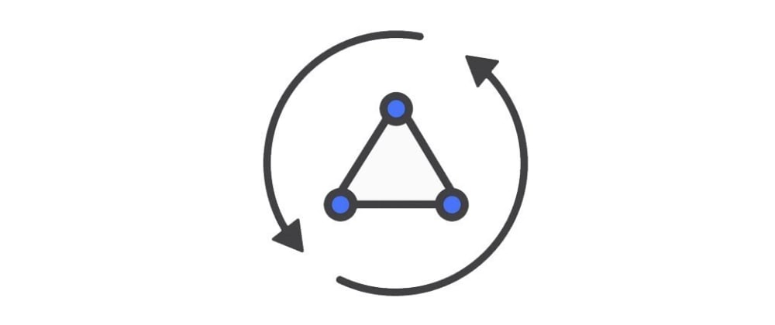



Architecture
AWS Cognito - Authenticator
Cloud Front
S3 Bucket
API Gateway
Angular APP- Git
AWS AppSync
AWS Lambda
AWS - Dynamo DB

Slide 3
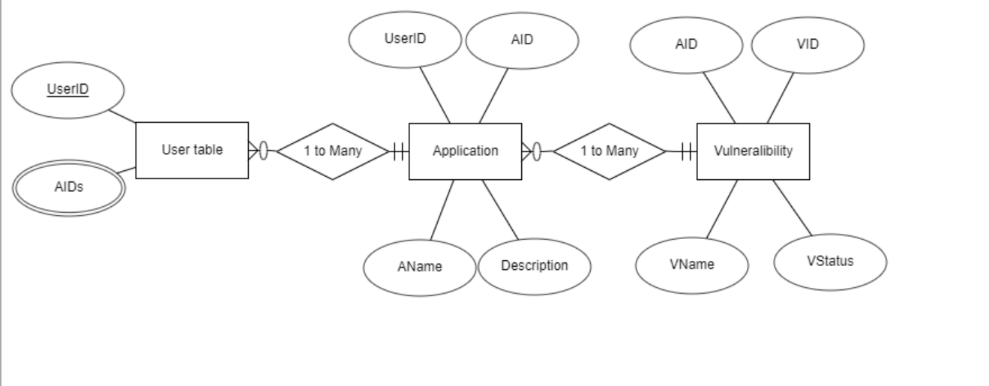
Database ERD Schema

Slide 4
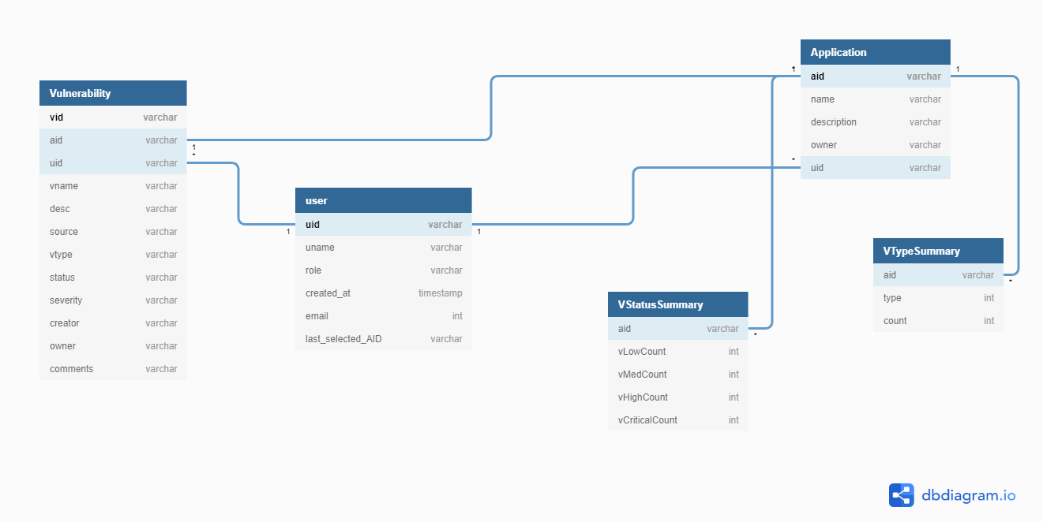
DB Table Schema

